Slide 1

Inclusion of OEM and eUICC Support
New TAC Application Process
28th Feb. 2017

Slide 2
Summary
  Terminal Steering Group (TSG) approved the inclusion of identifying the Original Equipment Manufacture and disclosing eUICC feature as additional requirements to the TAC Application and approval process.
  This presentation outlines the new process additions for the TAC applicants workflow.
  Key Process Change:
    Reporting Bodies will be responsible for verifying the details of Original Equipment Manufactures. Such verification shall be conducted in the same manner when a new IA registers.
    If the OEM is added by the TAC applicant during their TAC Application process then the new OEM must be approved prior to the RB being able to approve the TAC Application. If the OEM is not approved then the TAC application will automatically be rejected.
  Targeting this new process to “Go Live” on March 13th 2017

Slide 3
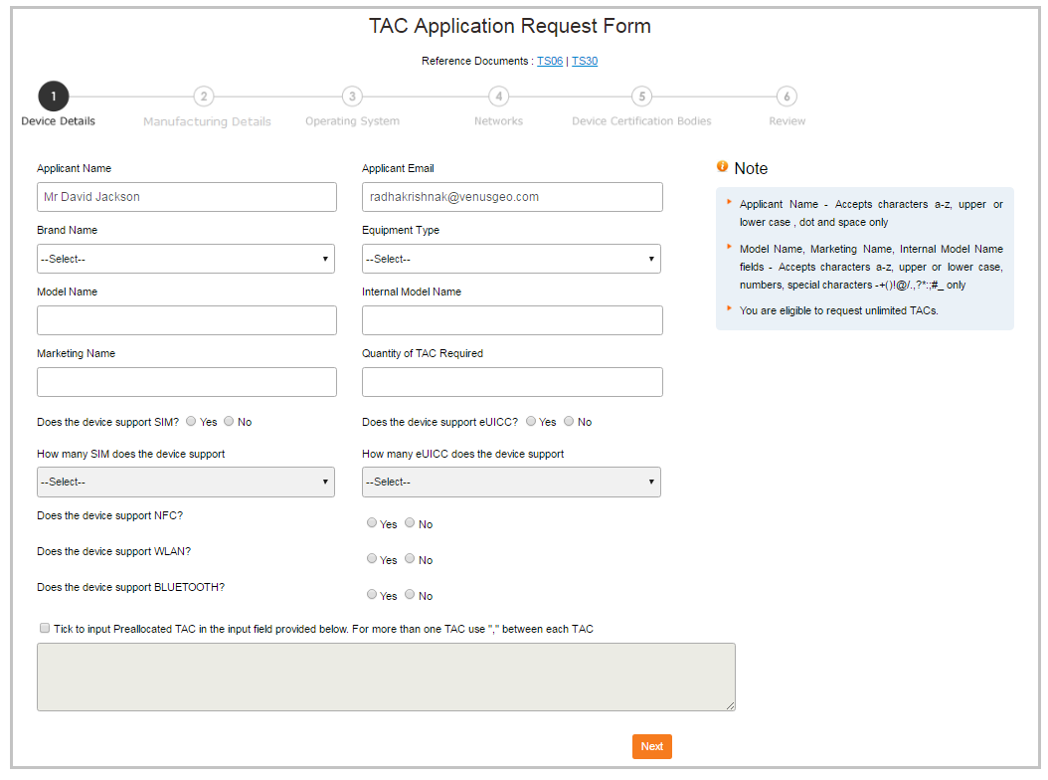
New TAC Application – Enter Device Details
TAC applicant should select if the device supports eUICC.
If the applicant selects ‘Yes’, the dropdown ‘How many eUICC does the device support’ will be active and will list options 1 eUICC to 4 eUICC
The form does not allow the applicant to select ‘No’ for both SIM and eUICC support. At least one must be selected “yes”

Slide 4
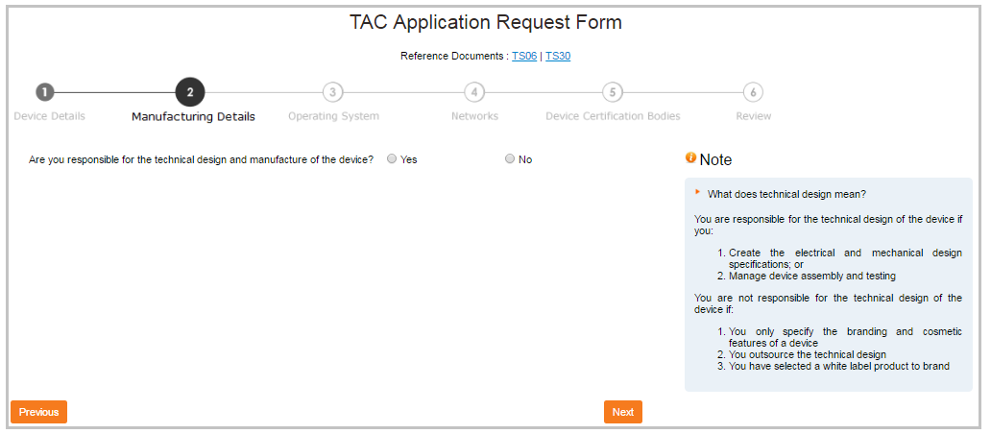
New TAC Application – Select Manufacturing Details

Slide 5
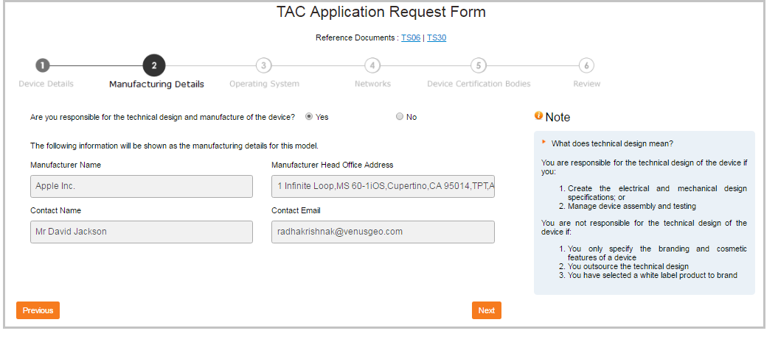
New TAC Application – Select Manufacturing Details
Brand Owner select ‘Yes’ if they are responsible for the technical design and manufacturer of the device
System automatically displays the brand owner details

Slide 6
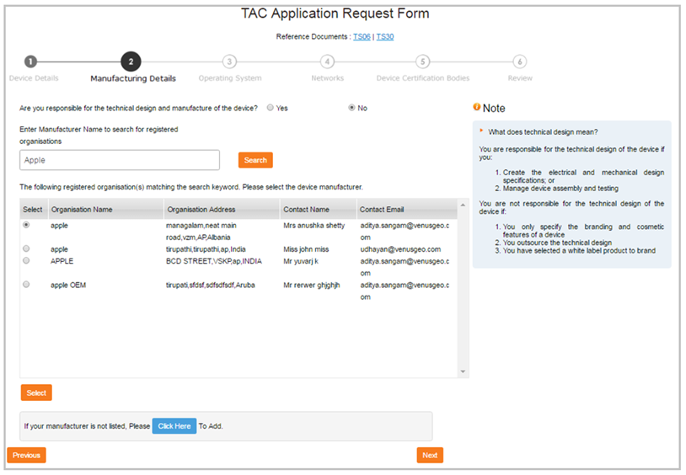
New TAC Application – Select Manufacturing Details
Applicant selects ‘No’ if the organization is not responsible for technical design
The applicant can search for the manufacturer from the list of registered manufacturer/organizations in the IMEIDB
System displays list of manufacturers matching the keyword
If the system does not find any manufacturer matching the search, it displays an option to add new manufacturer (Slide 7)
Applicant can select the manufacturer and click on ‘Select’
When the brand owner selects a manufacturer and clicks next the following text “pop up”. “Please note that the manufacturer may be contacted to verify the device details for which you are applying for the TAC. Incorrect information will delay and/or invalidate this TAC application”
If the manufacturer is not listed, applicant can click here to Add a new manufacturer (Slide 8)

Slide 7
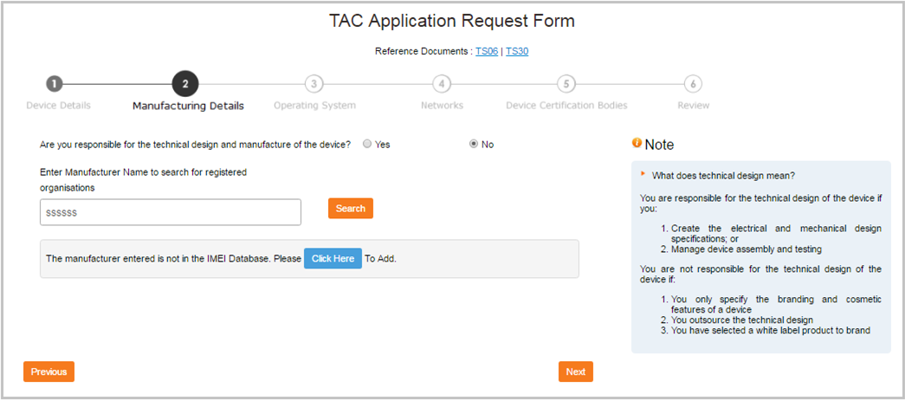
New TAC Application – Select Manufacturing Details
If the system does not find any manufacturer matching the search, it displays an option to add new manufacturer (Slide 8)
When Manufacture is new or not registered in the IMEIDB the TAC Applicant will
need to “Click Here” to register

Slide 8
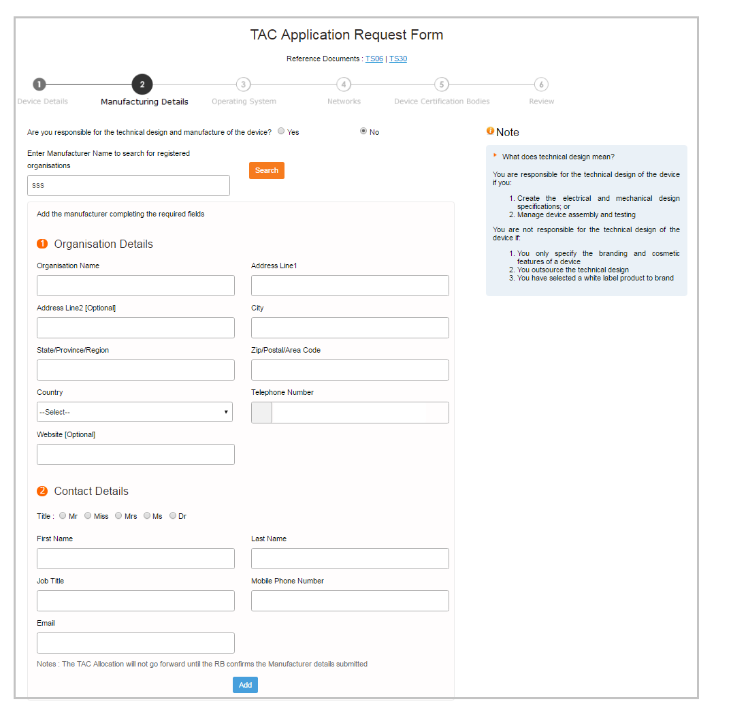
New TAC Application- Add Manufacturing Details
The TAC Applicant is required to complete the manufacturer details form as seen to the left. Once complete, the applicant clicks “Add”

Slide 9
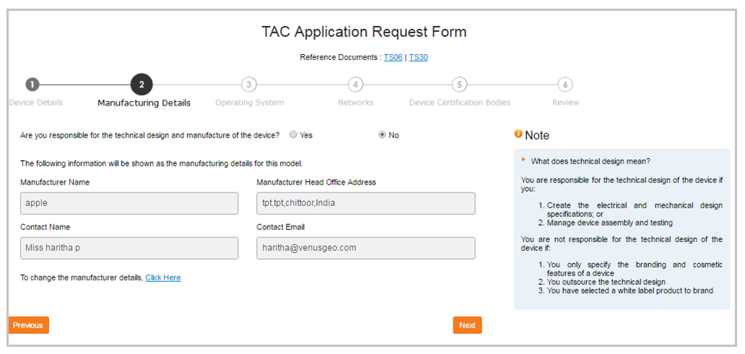
New TAC Application-Select Manufacturing Details
Once the new manufacturer is added, the System displays the details
Note: This organization must first be approved prior to TAC allocation. This will be covered in more detail in the RB process slides in this presentation.

Slide 10
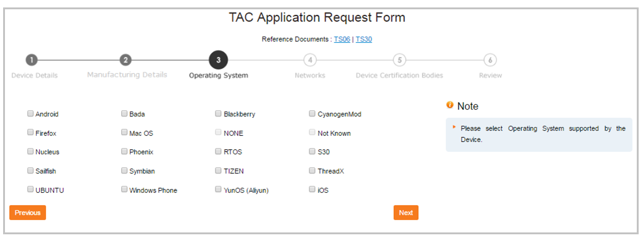
New TAC Application – Select Operating System

Slide 11
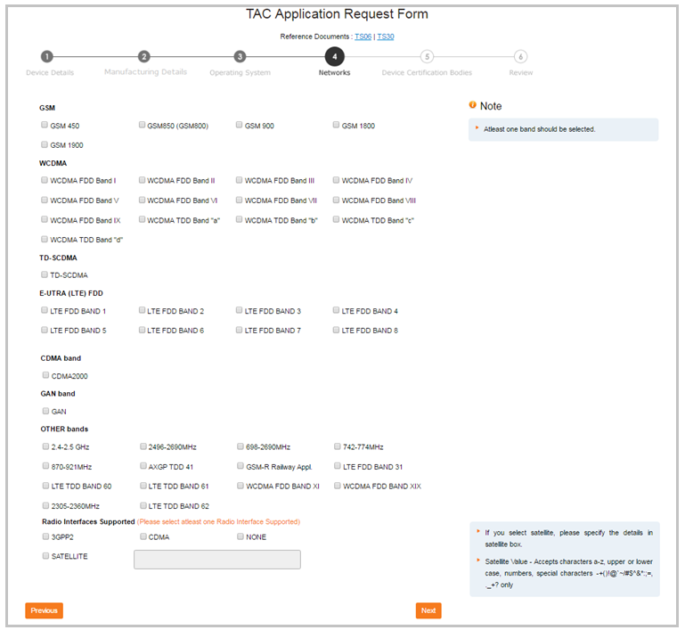
New TAC Application – Select Supported Networks

Slide 12
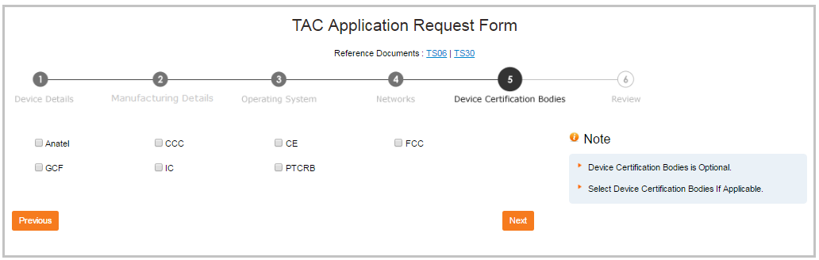
New TAC Application – Select Device Certification Bodies

Slide 13
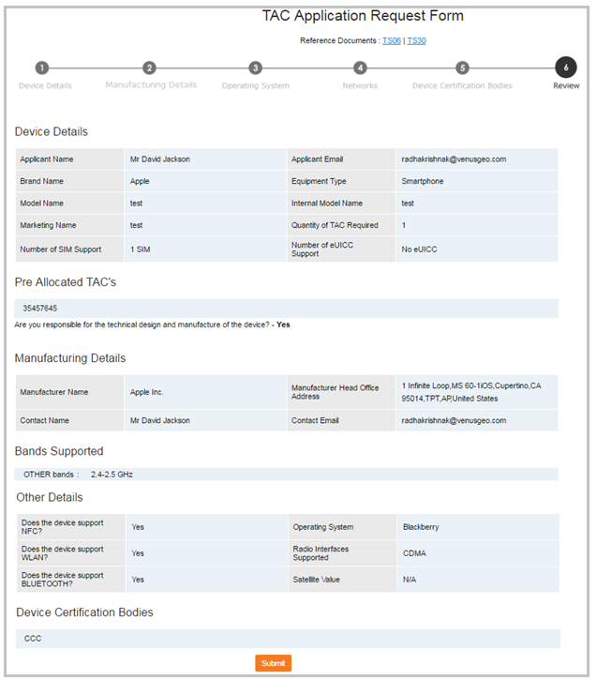
New TAC Application – Review and Submit Application
When a new manufacture is submitted by a brand owner the RB1 will be notified via the current TAC Request notification process, calling out that the Brand Owner has submitted such details.

Slide 14
Questions
For any questions or clarifications please reach imeihelpdesk@gsma.com

